Slide 1
INT222 - Internet Fundamentals
Week 12: AJAX and BOM

Slide 2
Agenda
AJAX
Simulating a call to a Web service
JSON
Browser Object Model

Slide 3
What is AJAX
AJAX stands for Asynchronous JavaScript and XML.
Coined in 2005 by Jesse James Garrett.
Not a technology , but a “new” way to use existing technologies.
AJAX is a group of interrelated web techniques used on the client-side for creating fast and dynamic web pages.

Slide 4
Technologies used in AJAX
HTML
CSS
JavaScript
The Document Object Model (DOM)
XML/JSON, XSLT
XMLHttpRequest object

Slide 5
AJAX Examples
Google Maps
http://maps.google.com/
Google Suggest
http://www.google.com/webhp?complete=1&hl=en

Slide 6
How does it works?
AJAX allows web pages to be updated asynchronously by exchanging small amounts of data with the server behind the scenes. This means that it is possible to update parts of a web page, without reloading the whole page.

Slide 7
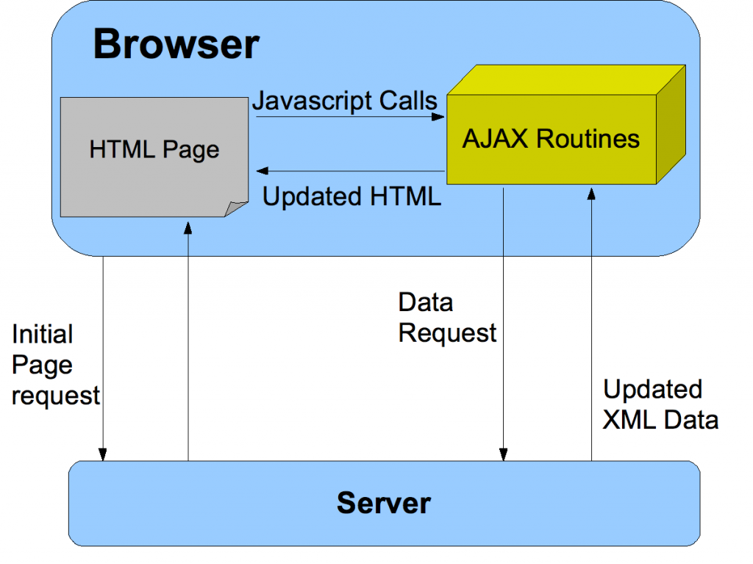
The AJAX model

Slide 8
Comparing with classic apps
Conventional web application transmit information to and from the sever using synchronous requests. This means you fill out a form, hit submit, and get directed to a new page with new information from the server.

Slide 9
Packaging data in AJAX model
XML was originally used as the format in AJAX.
JSON is used more than XML nowadays .
Advantages to use JSON: being lighter and a part of JavaScript.
Any format, including plain text, can be used.

Slide 10
Features
Make requests to the server without reloading the page
Receive and work with data from the server
AJAX is a web browser technology independent of web server software.
A user can continue to use the application while the client program requests information from the server in the background
Intuitive and natural user interaction. No clicking required only Mouse movement is a sufficient event trigger.
Data-driven as opposed to page-driven

Slide 11
XMLHttpRequest object
It is the most important part of AJAX.
It is a JavaScript object
Designed by MS and adopted by Mozilla, Apple, …
It provides an easy way to retrieve data from a URL without having to do a full page refresh.
Creation:
var myRequest = new XMLHttpRequest();

Slide 12
XMLHttpRequest Methods
abort()
getResponseHeader()
open() // Initializes a request.
overrideMimeType()
send() // Sends the request.
…

Slide 13
XMLHttpRequest properties
Onreadystatechange
readyState
responseText
responseType // set to change the response type
responseXML

Slide 14
Writing AJAX
Step 1 – makes an HTTP request object
// creating a cross-browser instance
var httpRequest;
if (window.XMLHttpRequest) { // Mozilla, Safari, ...
httpRequest = new XMLHttpRequest();
} else if (window.ActiveXObject) { // IE 8 and older
httpRequest = new ActiveXObject("Microsoft.XMLHTTP");
}

Slide 15
Writing AJAX
Step 2 – register a request listener
httpRequest.onreadystatechange = reqListener;
function reqListener () {
// process the server response
};
Or:
httpRequest.onreadystatechange = function(){
// process the server response
};

Slide 16
Writing AJAX
Step 3 - make the request
// Specifies the type of request
httpRequest.open('GET', 'http://www.example.org/some.file', true);
// Sends the request off to the server.
httpRequest.send(null);

Slide 17
Parameters of open() and send()
Parameters of the open(method, url, async) method:
1st para: HTTP request method - GET, POST, …
2nd para: the URL of the page this requesting
3rd pare: sets whether the request is asynchronous
Parameters of the send(string) method:
The “string” para: Only used for POST requests.
any data you want to send to the server if using POST method. This can be as a query string, like:
name=value&anothername="+encodeURIComponent(myVar)+"&so=on"

Slide 18
Writing AJAX
Step 4 – handling the server response
// check for the state of response
if (httpRequest.readyState === 4) {
// everything is good, the response is received
} else {
// still not ready
}
the readyState values:
0 (uninitialized), 1 (loading), 2 (loaded), 3 (interactive), 4 (complete)

Slide 19
Writing AJAX
Step 4 – handling the server response (cont’)
// check is the response code of the HTTP server response
if (httpRequest.status === 200) {
// perfect!
} else {
// there was a problem with the request,
// for example the response may contain a 404 (Not Found)
// or 500 (Internal Server Error) response code
}

Slide 20
Writing AJAX
Set the button to start
<button type=“button" onclick="makeRequest();">
Make a request</button>

Slide 21
Working with the XML response
Suppose server response is in XML format:
<?xml version="1.0" ?>
<root>
I'm a test.
</root>
Parsing XML data
var xmldoc = httpRequest.responseXML;
var root_node = xmldoc.getElementsByTagName('root').item(0);
alert(root_node.firstChild.data);

Slide 22
Working with the JSON response
Suppose server response is in JSON format:
{"name": "Kevin", "age": 22 }
Parsing JSON data:
// Javascript function JSON.parse to parse JSON data
var jsonObj = http_request.responseText;
var jsObj = JSON.parse(jsonObj);
var name = jsObj.name;
var age = jsObj.age;

Slide 23

About JSON
JSON stands for JavaScript Object Notation.
specified by Douglas Crockford.
a lightweight text based data-interchange format.
"self-describing" and easy to understand
smaller than XML, and faster and easier to parse
JSON parsers and JSON libraries exists for many different programming languages.
e.g. C, C++, Java, Python, Perl, PHP etc.
JSON filename extension is .json
JSON Internet Media type is application/json

Slide 24
JSON Structures
JSON is built on two structures:
JSON object: a collection of name/value pairs.
{ "firstName": "John",
"lastName": "Smith", "age": 25,
"address": { "street": "21 2nd Street",
"city": "North York",
“province": “ON",
"postalCode": “M2M6T6" }
}
JSON array: an ordered list of values.
[
{"name" : "Kevin", "age" : 22, "gender" : "m"},
{"name" : "Kate", "age" : 22, "gender" : "f"},
{"name" : "Steven", "age" : 25, "gender" : "m"},
{"name" : "Bill", "age" : 22, "gender" : "m"}
]

Slide 25
JSON Objects vs JavaScript Objects
JSON and JavaScript use the same syntax to describe data objects, including Arrays.
But JSON objects are text-based or "string"s.
The properties of JSON objects have to be qouted.
e.g.
{"name": "Kevin", "age": 22 }

Slide 26
JSON Objects vs JavaScript Objects
Conversion between JSON and JavaScript objects – using JS built-in object: JSON
Serializing JavaScript object (converting JavaScript object to JSON object ) :
var jsObject = { "language" : "Java", "course" : "JAC444" };
var JSONString = JSON.stringify(object1 );
Parsing JSON string (converting JSON object to JavaScript object ) :
var JSONString2 = '{ "language" : "C++", "course" : "OPP344" }';
var jsObject2 = JSON.parse(JSONString2);

Slide 27
JSON vs XML
A JSON object
{ "menu": { "id": "file",
"value": "File",
"popup": {
"menuitem": [
{"value": "New", "onclick": "CreateDoc()"},
{"value": "Open", "onclick": "OpenDoc()"},
{"value": "Close", "onclick": "CloseDoc()"} ]
} } }
Equivalent XML document
<?xml version="1.0" ?>
<root>
<menu id="file" value="File">
<popup>
<menuitem value="New" onclick="CreateDoc()" />
<menuitem value="Open" onclick="OpenDoc()" />
<menuitem value="Close" onclick="CloseDoc()" />
</popup>
</menu>
</root>

Slide 28
JavaScript: simulating AJAX calls to Web Services
Example 1: calling a web service with JSON object response
Code: https://zenit.senecac.on.ca/~wei.song/int222/ajax/ajaxjson.html
Example 2: calling a web service with JSON array response
Code: https://zenit.senecac.on.ca/~wei.song/int222/ajax/ajaxjson2.html

Slide 29
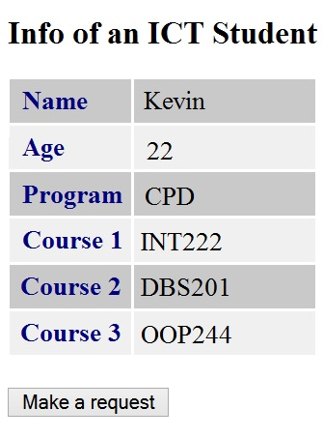
Exercise
Create an HTML5 page that loads data with an AJAX call to a web service.
The web service is simulated by a static JSON file: https://zenit.senecac.on.ca/~wei.song/int222/json/student.json
You have to HTML page to the ZENIT server to make the AJAX code work.
ATTN: usually, Cross-Domain AJAX call is not allowed for security reason.
The HTML page is showed at right.

Slide 30
Browser Object Model
(BOM)

Slide 31
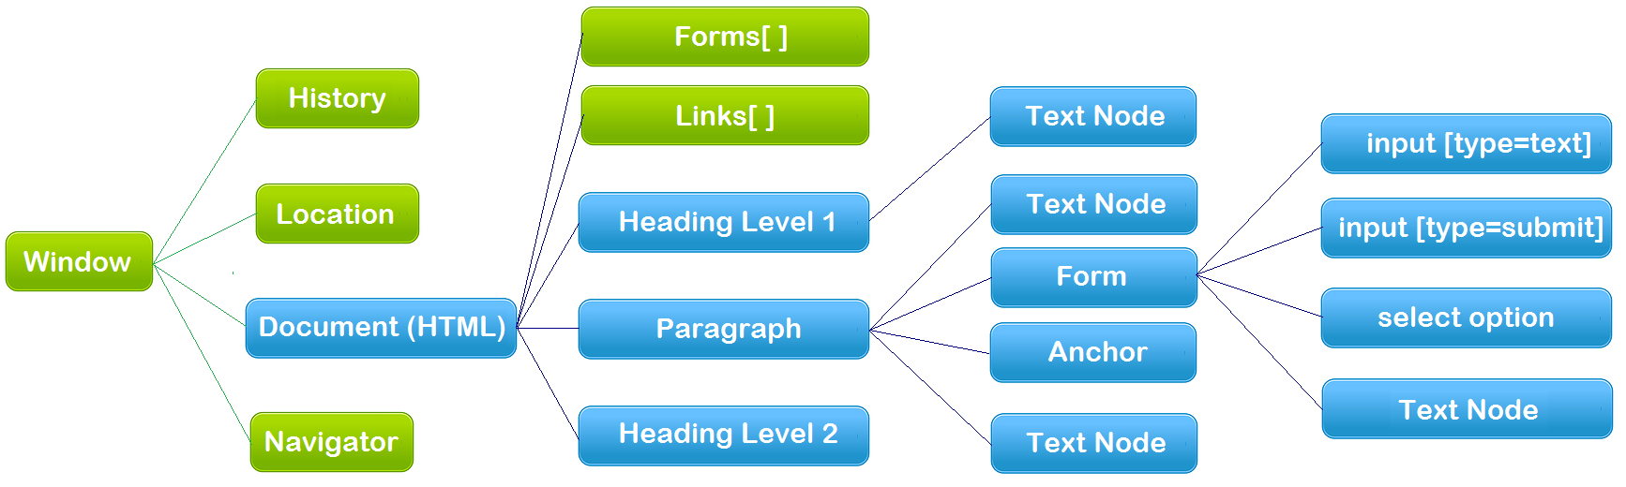
The Browser Object Model (BOM)
Browser Object Model (BOM) is the collection of objects which define the browser window and its contents within the browser that can be accessed by JavaScript.
The hierarchy of browser objects

Slide 32
The Browser Object Model (BOM)
Many people mix the concepts of Browser Object Model (BOM) with Document Object Model (DOM).
Strictly, DOM is subset of BOM. (See the blue part of the diagram in last page, and we’ll cover or in future class).
There are no official standards for the Browser Object Model (BOM).
But, the DOM is a W3C (World Wide Web Consortium) standard.
The top level of the BOM hierarchy is the window object, which contains all other objects:
location object,
history object,
document object,
navigator object

Slide 33
Browser Object - window
An open window in a browser.
The top level object in the browser Object hierarchy.
All other objects derive from the window.
Global variables are properties of the window object.
Global functions are methods of the window object.

Slide 34
Browser Object - window
Property: document
Syntax: window.document or document
Property: location
Syntax: window.location or location
Property: history
Syntax: window.history or history
Property: navigator
Syntax: window.navigator or navigator

Slide 35
BOM – Window Object
Method – open()
Opens a new browser window
Syntax:
var winObjRef = window.open(strUrl, strWindowName, [strWindowFeatures]);
strUrl, optional. Open the page in the URL. If no URL (empty string “”), a new window with about:blank is opened
strWindowName, Optional. Specifies the target attribute or the name of the window.
_blank - URL is loaded into a new window. default
_parent - URL is loaded into the parent frame
_self - URL replaces the current page
_top - URL replaces any framesets that may be loaded
name - The name of the window

Slide 36
BOM – Window Object
[strWindowFeatures], an optional parameter listing the features (size, position, scrollbars, etc.) of the new window as a string.
The string must not contain any whitespace, and each feature name and its value must be separated by a comma.
See Position and size features details from this link.
e.g.
"toolbar=no,menubar=no,scrollbars=yes,resizable=yes,directories=no,status=no,location=no,width=450,height=550"

Slide 37
BOM – Window Object
Example: open and write a new page
var myWindow = window.open('', 'winName', 'width=400,height=200, scrollbars = yes');
myWindow.document.write("<p> write to new window in <span style = 'color: blue;'> blue </span>. </p>");
myWindow.document.close(); //closes the output stream to the document.
myWindow.theWindow.focus();
// myWindow.close();

Slide 38
BOM – Window Object
Examples: open an existing web pages
window.open('http://www.google.com');
myWindow =
window.open('http://www.google.com','MsgWindow','width=400, height=200');
// myWindow.focus();
// myWindow.blur();
// myWindow.close();
js-window-open.html

Slide 39
Browser Object - Window
Method: close()
Close the current window.
Property: name
Sets or returns the name of the window.
Method: blur()
removes focus from the current window(send the window to the background).
Method: focus()
sets focus to the current window.
Method: moveBy()
moves a window a specified number of pixels relative to its current coordinates.
Method: moveTo(x,y)
moves a window's left and top edge to the specified coordinates.

Slide 40
Browser Object - Window
js-window-focus.html
js-window-moveByTo.html

Slide 41
Browser Object - Window
Global built-in functions
Alert box: alert("An alert box!");
Confirm box: var ans = confirm("Are u ok?");
Prompt box: var namw = prompt(“Enter your name", “Bill");
inNaN(), isFinite()
parseInt(), parseFloat(), Number()
eval()
Global properties
Infinity, NaN, undefined
JavaScript built-in objects
String, Array, Date, Number, …
Custom functions, global variables

Slide 42
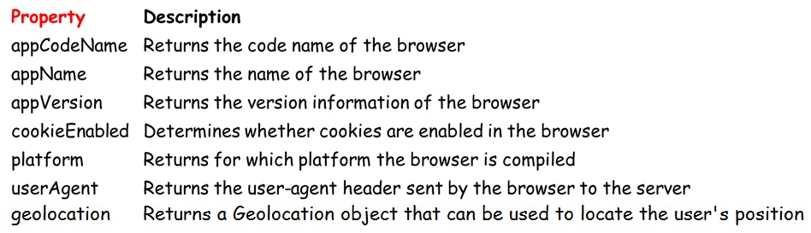
Browser Object - Navigator
The navigator object contains information about the browser.
js-navigator.html

Slide 43
Browser Object - History
The History object interface allows to manipulate the browser session history
The history object contains the URLs visited by the user (within a browser window).
The window.history read-only property returns a reference to the History object.

Slide 44
Browser Object - History
Property: length
Returns the number of URLs in the history list.
Snytax: history.length
Note: Internet Explorer and Opera start at 0, while Firefox, Chrome, and Safari start at 1.
Method: go()
Loads a specific URL from the history list.
Syntax: history.go( number|url )
The parameter can either be:
a number which goes to the URL within the specific position (-1 goes back one page, 1 goes forward one page)
a string that must be a partial or full URL, and the function will go to the first URL that matches the string.

Slide 45
Browser Object - History
Method: back()
Syntax: history.back()
The back() method loads the previous URL in the history list.
This is the same as clicking the Back button or history.go(-1)
Method: forward()
Syntax: history.forward()
The forward() method loads the next URL in the history list.
This is the same as clicking the Forward button or history.go(1).

Slide 46
History - Examples
history.go('https://cs.senecac.on.ca')
the function will go to the first URL that matches the string.
history.go(-3)
goes to the URL the user visited three clicks ago in the current window.
js-history.html

Slide 47
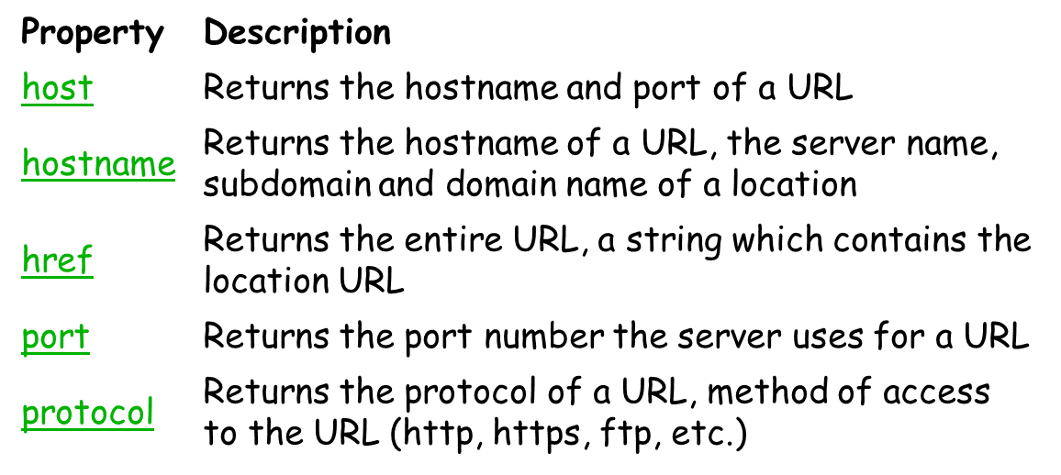
Browser Object - location
The location object contains information about the current URL.
The location object is part of the window object and is accessed through the window.location property.

Slide 48
Browser Object - location
Redirect web page (in JS)
<script>
location.href='http://www.senecacollege.ca/';
// or
// location='https://open.senecac.on.ca/cms/‘;
</script>
js-location.html

Slide 49
Resource & Reference
MDN: AJAX - Getting_Started
https://developer.mozilla.org/en-US/docs/AJAX/Getting_Started
JavaScript Object Notation (JSON)
Browser Object Model - Wikipedia, the free encyclopedia

Slide 50
Thank You!

